Slide 1

HARDWARE COOLING IN COMPUTERS EVALUATING THE EFFICACY OF A PIEZOELECTRIC FAN FOR THERMAL DISSIPATION OF A CPU IN A DESKTOP COMPUTER By Matthew Dunaway

Slide 2
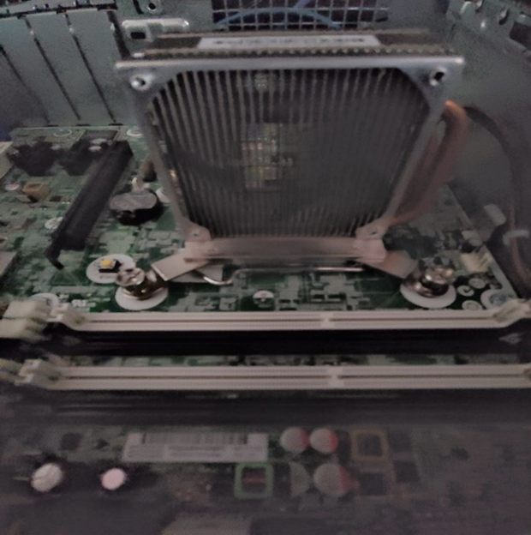
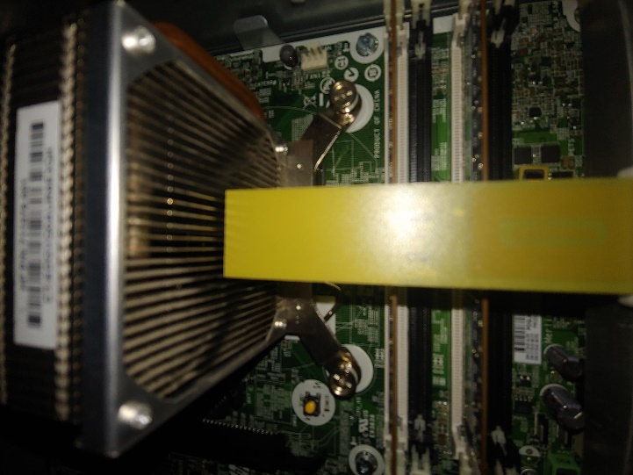
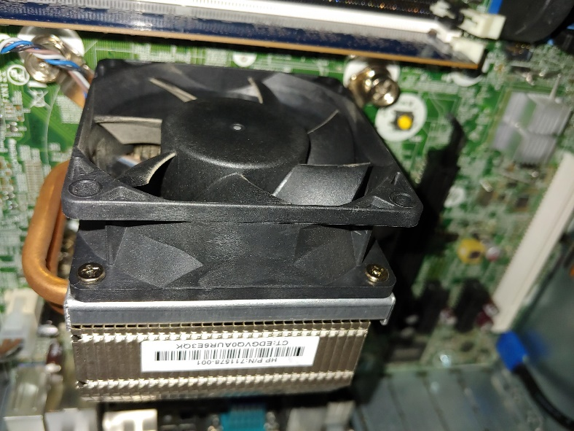
Overview- Project Goals
Test if a PZ Fan Can Cool a CPU Enough to Prevent Thermal Shutdown at 100°C
Measure the Thermal Reduction Efficiency of Each Fan compared to No Fan
Measure Air Flow Speeds to Correlate Air Flow To Thermal Reduction Efficiency
No-Fan / Natural Convection
Rotary Fan / Forced Convection
Piezoelectric Fan (PZ)/ Forced Convection

Slide 3
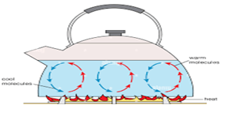
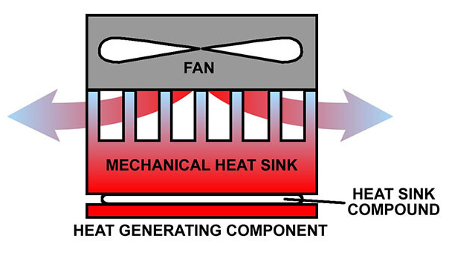
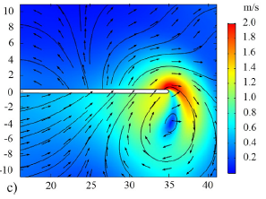
Background- Cooling Techniques
No Fan
Rotary Fan
PZ Fan
Not Powered By Any External Force
Dependent on Gravity and Ambient Temp Gradient
Hot Air = Less Dense = Rises
Cold Air = Denser = Falls
Rapid Heat Generation Can Make Natural Convection Ineffective in Hardware Cooling
Powered by Electromagnetism Pushing and Pulling Rotor
Dependent on Forced Air Flow Rate
Forced Air Absorbs Heat and Maintains Temp Gradient
Rapid Heat Generation Rarely Outpaces Laminar Air Flow
Most Effective Hardware Cooling Solution
Powered by Piezoelectricity
Dependent on Forced Air Flow Rate
Forced Air Absorbs Heat and Maintains Temp Gradient
Rapid Heat Generation Can Overtake Vortex Flow
Research Suggests Not as Effective as Rotary Fan

Slide 4
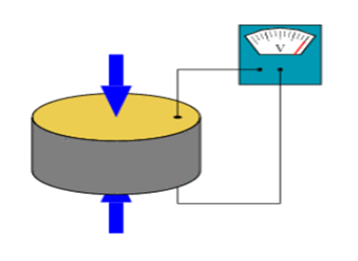
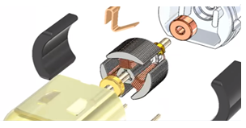
background-Fan Attributes
 | PZ Fan | Rotary Fan
Power Consumption | 1 Watt | 6 Watts
Rotation | No Rotating Parts (Electricity Flexes a Crystal Lattice) | Metal-To-Metal (Require Lubrication)
EMI Emission | None | Yes
Durability in Adverse Conditions | Highly Durable | Limited Durability
Operating Temperature | -60°C to 120°C | -40°C to 60°C
Air Flow | Vortex | Laminar

Slide 5
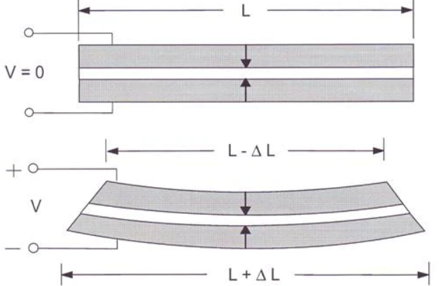
Research Review of piezoelectric fans
Used for Augmenting Primary Cooling Solution
Seen in Industrial and Telecomm Industries
Hundreds of Research Articles on Thermal Dissipation Efficacy of Piezoelectric Fans
Researchers Concluded Not Enough Air Flow to Dissipate CPU Heat in Standalone Test
No Research Articles on Thermal Dissipation of PZ Fan in a Desktop Computer

Slide 6
Test Setup
Three test cases were conducted to determine the Piezoelectric Fan’s cooling ability and thermal efficiency compared to alternative fan setups:
Hardware Used
Twenty Hour Cooling: Completed two rounds of Max CPU Temperature testing with temperatures logged for each fan setup every .5 seconds for a 20-Hour Period.
100% Utilization Cooling: Completed two rounds of Max CPU Temperature with temperatures logged for each fan setup every .5 seconds for a 1-minute period.
Fan Flow Velocity: Air Flow Speeds Measured to Correlate Air Flow To Thermal Efficiency for Each Fan Setup
Computer: Hewlett Packard ProDesk 600 G1 SFF Slim Business Desktop
CPU: Intel Pentium i5 4590 Processor with 4 cores, 3.70 GHz processing frequency, and 84 Watts of thermal design power (power consumed)
Rotary Fan: FoxConn 12VDC 0.50A Brushless Fan Model Number PVA070G12Q
PZ Fan: Piezo.com KIT-012 120 VAC 60Hz Piezoelectric Fan
CPU Temp Monitoring and Performance Simulation Software: CPUID’s HW Monitor Pro v1.09 and PowerMAX

Slide 7
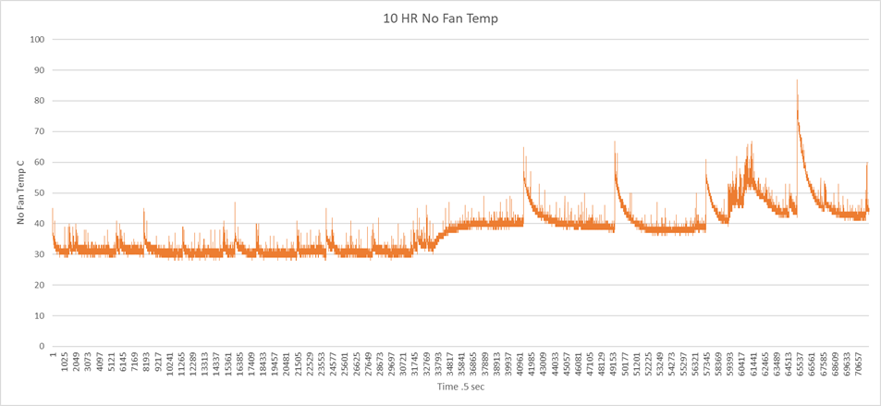
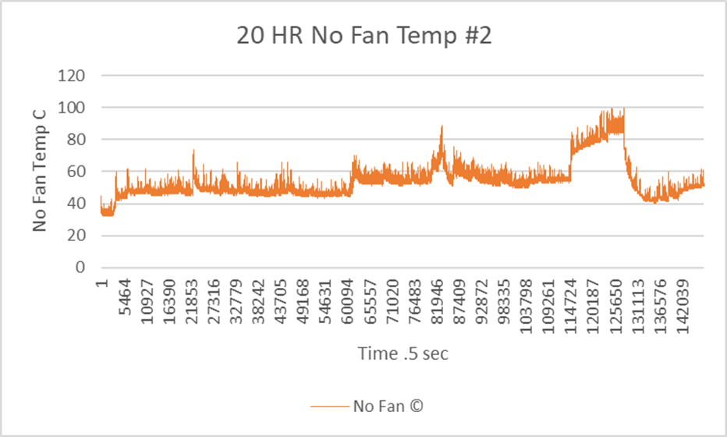
Results
Test Case
20-Hour Cooling - No Fan
Test I
Test II
Avg CPU Temp: 37.38°C
Min CPU Temp: 28°C
Max CPU Temp: 87°C
Avg CPU Temp: 52.88°C
Min CPU Temp: 32°C
Max CPU Temp: 100°C
For both tests, ambient temp held at 21.66-24.44°C and humidity At 50-55%. Only 71,618 Temp Data Points Charted (~10 Hours) From Test #1 because Temp Spiked To a critical 87°C; 147,499 Temp Data Points From Test #2 Charted (~20 Hours)

Slide 8
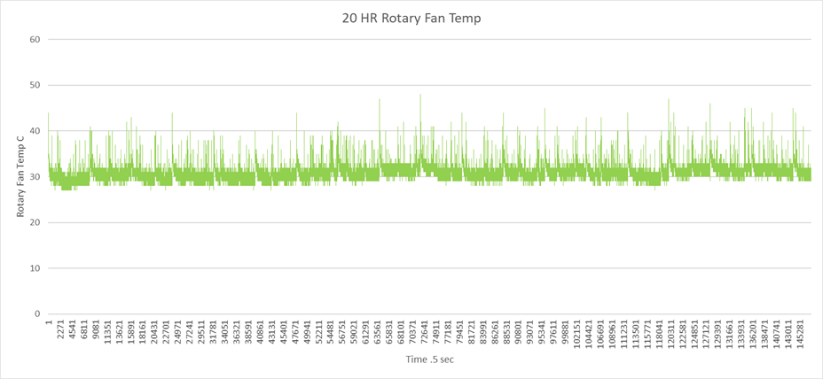
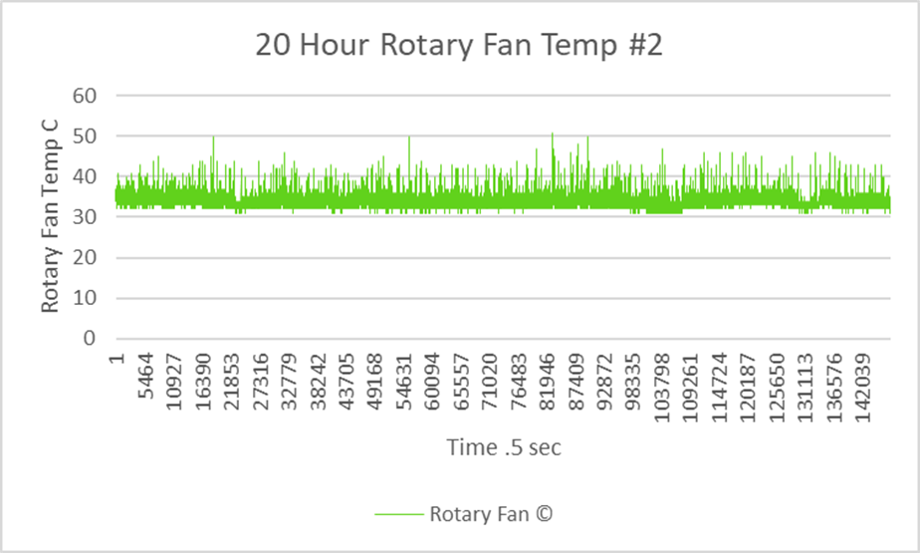
Results
Test Case
20-Hour Cooling - Rotary Fan
Test I
Test II
Avg CPU Temp: 33.53°C
Min CPU Temp: 31°C
Max CPU Temp: 51°C
Avg CPU Temp: 30.78°C
Min CPU Temp: 27°C
Max CPU Temp: 48°C
Note: For both tests, ambient temp held At 21.66-24.44°C, humidity At 50-55%, and147,499 Temp Points Charted (~20 Hours)

Slide 9
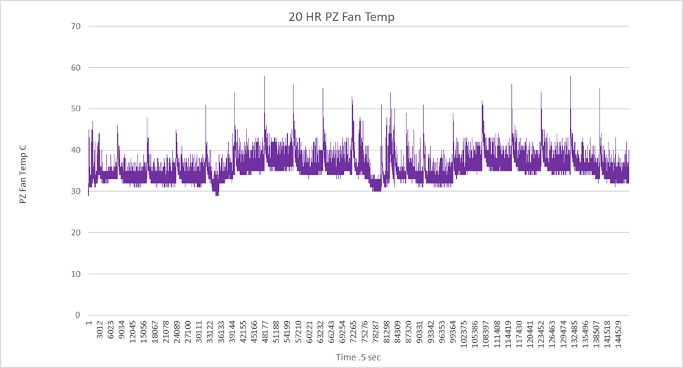
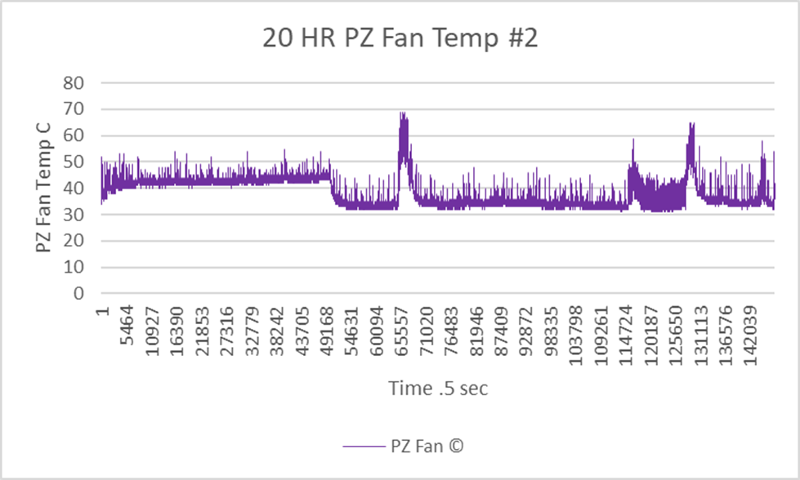
Results
Test Case
20-Hour Cooling - PZ FAN
Test I
Test II
Avg CPU Temp: 37.76°C
Min CPU Temp: 31°C
Max CPU Temp: 69°C
Avg CPU Temp: 35.20°C
Min CPU Temp: 29°C
Max CPU Temp: 58°C
Note: For both tests, ambient temp held At 21.66-24.44°C, humidity At 50-55%, and147,499 Temp Points Charted (~20 Hours)

Slide 10
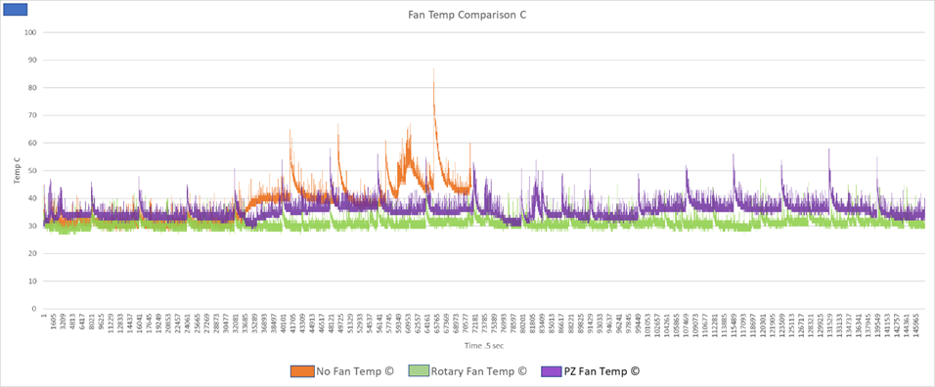
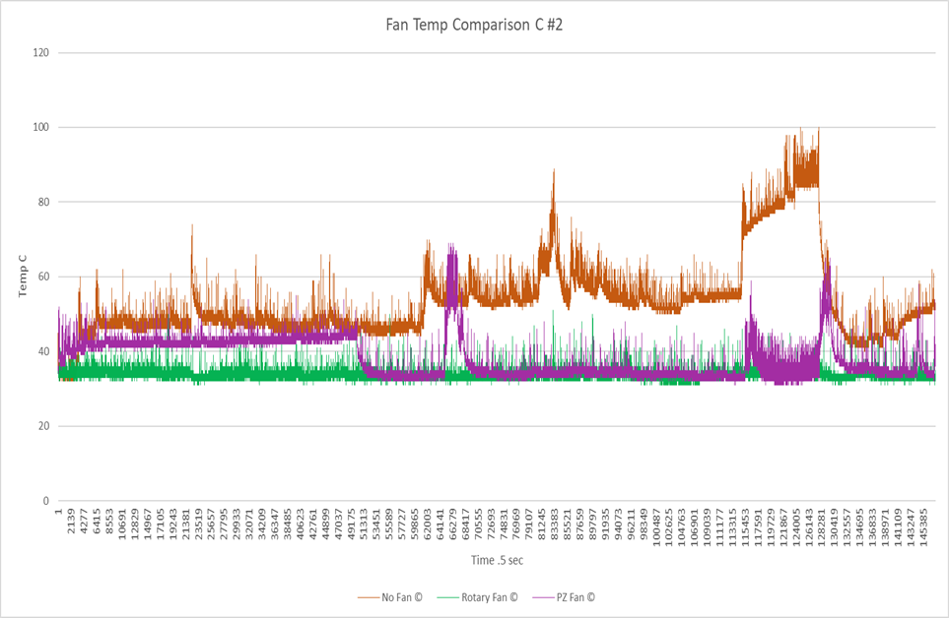
Test Case 20-Hour Cooling
Results
- Fan Comparison
Test I
Test II
Avg No Fan Temp: 37.38°C
Avg PZ Fan Temp: 35.20°C
Avg Rotary Fan Temp: 30.78°C
Avg No Fan Temp: 52.88°C
Avg PZ Fan Temp: 37.76°C
Avg Rotary Fan Temp: 33.53°C
Rotary and PZ Fan Temps from Test I to Test II were within ~3°C of each other
Variance in Avg No Fan temperatures are attributed to differences in testing duration
Considering Ambient Temp Range Varied by +-2.22°C, CPU Avg Temps Substantiate Reproducibility

Slide 11
Test Case 20-Hour Cooling
Results
- Fan Comparison
Fan Type | Test #1 CPU Temp AVG © | Test #2 CPU Temp AVG © | Test #2 Thermal Reduction Efficiency %
No Fan | 37.38 (10hrs) | 52.88 | --
Rotary | 30.78 | 33.53 | 36.59
PZ | 35.20 | 37.76 | 28.59
No Fan CPU Avg Temp Increased From 37.38°C to 52.88°C Due to Full Test II Run
Thermal Reduction Efficiency was Calculated From Test II Averages
Rotary Fan Efficiency was 36.59% and PZ Fan Efficiency was 28.59%.
The PZ Fan performed within 8% Efficiency of the Rotary Fan without any Optimization or Customization

Slide 12
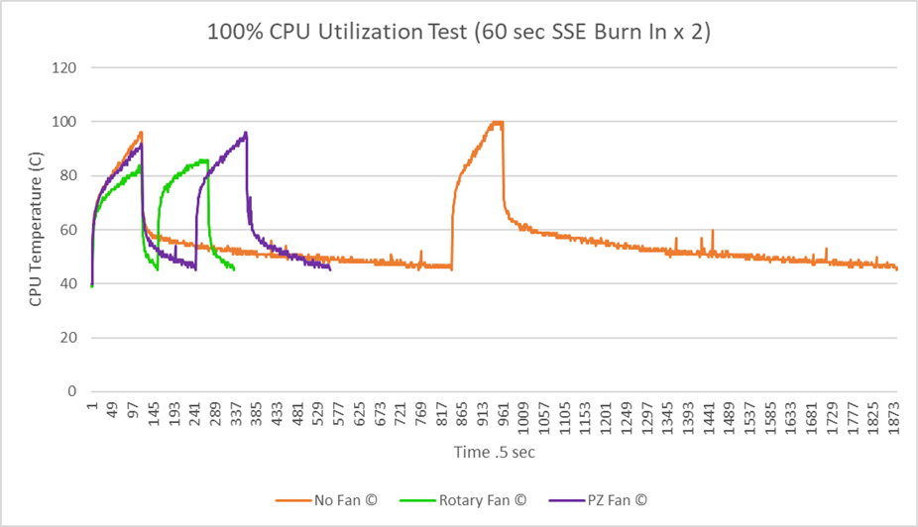
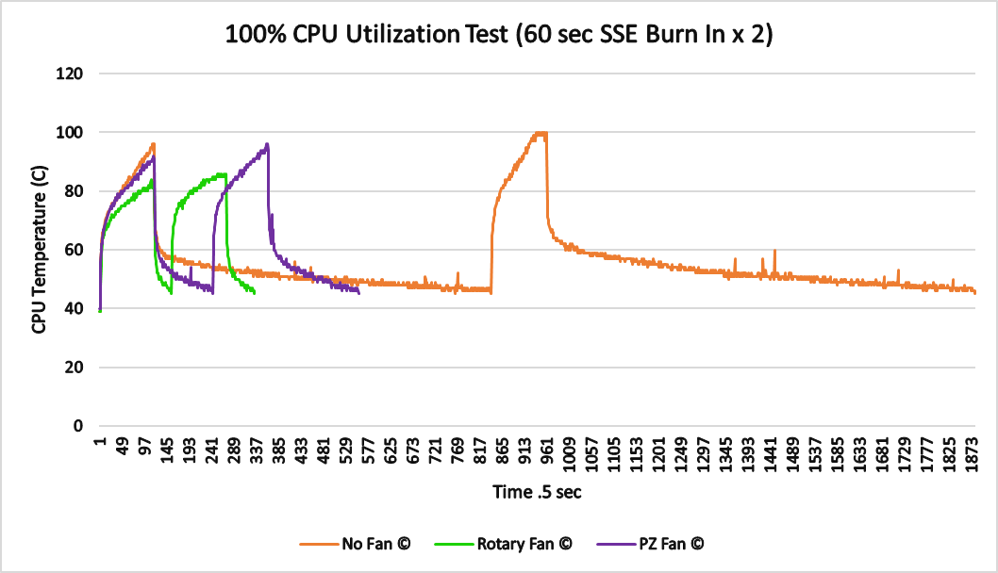
Results
Test Case 100% Utilization cooling
- Fan Comparison
Fan Type | Test 1 |  | Test 2
Fan Type | Max CPU Temp | Cooldown Time to 45°C (.5 sec) | Max CPU Temp | Cooldown Time to 45°C (.5 sec)
No Fan | 96°C | 368.5 | 100°C | 466.5
Rotary | 83°C | 18.5 | 86°C | 30.0
PZ | 91°C | 63.5 | 96°C | 98.0
Test Started at ~40°C CPU Temp & Restarted at 45°C CPU Temp
Even at 100% Utilization, PZ Fan kept CPU Temp Below 100°C

Slide 13
Results
Test Case Fan Flow Velocity
- Fan Comparison
Fan Type | Pre Heat Sink Flow Velocity(mph) | Post Heat Sink Flow Velocity(mph) | Ambient Temperature Change ©
No Fan | 0.0 | 0.0 | 0.0
Rotary | 6.54 | 6.0, 22.5, 44.0 | 0.0
PZ | 2.56 | 0.5 | -0.8
Flow Velocity & Wind Temp Measured With Anemometer
Efficiency Expected From PZ Fan Flow Velocity was 14.32%
Actual PZ Fan Efficiency was 28.59%
No Correlation Observed Strictly From Flow Velocity

Slide 14
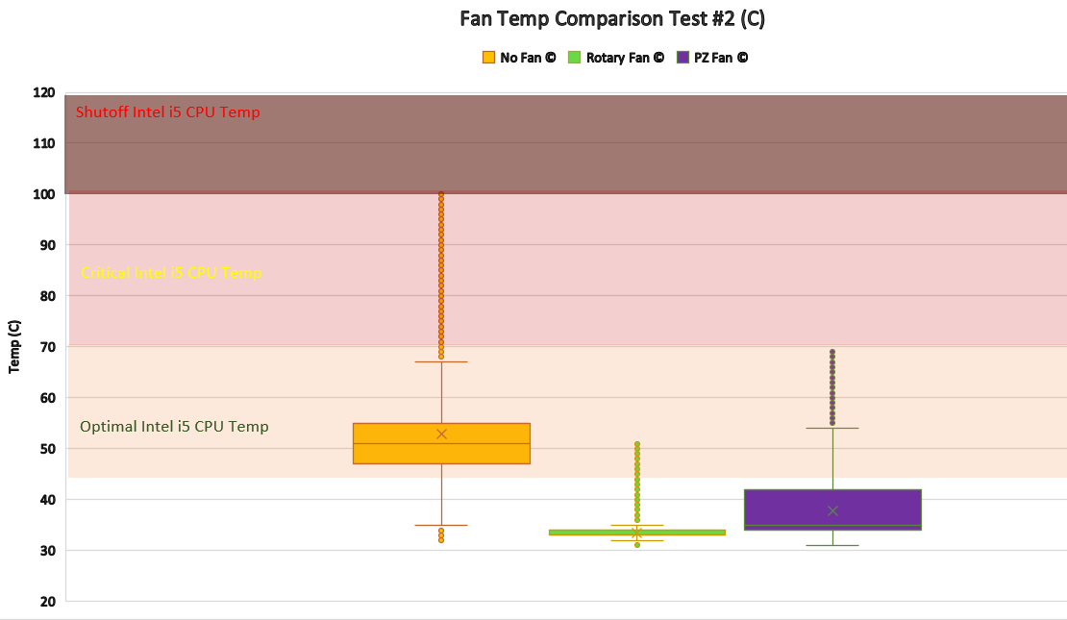
Conclusion
PZ Fan Maintained CPU Temp Below Optimum Temp in both 20 Hour Tests
PZ Fan Maintained Avg CPU Temp Within ~4.5°C of Rotary Fan in both 20 Hour Tests
PZ Fan Maintained CPU Temp Below Shutoff Temp in 20 Hour Test and 100% Utilization Test
PZ Fan Was 6X more Energy Efficient Than Rotary Fan
Reduction in PZ Fan Flow Velocity Did Not Strictly Correlate To a Decrease in Efficiency
Vortex Formation Could Cause the PZ Fan to have Higher Than Expected Efficiency

Slide 15

Recommendations
Perform 20 HR Runs with 30% CPU Utilization, the National Utilization Avg
Further Testing of PZ Fans in a Variety of Desktop and Laptop Computers
Further Testing of Approaches to Enhance PZ Efficiency (PZ Material, Flow Housing, Heatsink Designs)
Feasibility Testing in Enterprise Applications for Energy/Cost Savings of 4-16% (250W Desktop, 60W Laptop)

Slide 16
Acknowledgement
I would like to thank my parents Donnie and Becky Dunaway for purchasing the PZ fan. Thank you to Dr. Alexander Mezei, Buck Frymier, and Jonathan Hall for proofing this research paper. Thank you to Peter Truax for helping me walk through the testing methodology and technical aspects of this research paper.
I would also like to express my deep appreciation to Dr. Xuguang Chen, my project advisor, who encouraged me to take on this difficult project when it did not look or sound feasible. He has been a fantastic advisor whose wisdom and guidance have been invaluable to me in completing this experiment and fulfilling the requirements of the Master’s Degree in Computer Science.

Slide 17
References
1. Fisher, T. (2021). Do You Actually Know What Your PC's Motherboard Does? Retrieved 24 August 2022, from https://www.lifewire.com/motherboards-system-boards-and-mainboards-2618154.
2. Sheldon, R. (2021). What is solid-state technology and how is it used?. Retrieved 24 August 2022, from https://www.techtarget.com/whatis/definition/solid-state
3. Wang, Y. (2017). Power Efficiency of Piezoelectric Fan Cooling. Retrieved 27 August 2022, from https://escholarship.org/uc/item/7t55h4hz
4. Solid-state electronics - Wikipedia. (2022). Retrieved 27 August 2022, from https://en.wikipedia.org/wiki/Solid-state_electronics
5. Kazmeyer, M. (2022). How Does a CPU Cooling Fan Work?. Retrieved 19 September 2022, from https://smallbusiness.chron.com/cpu-cooling-fan-work-61608.html
6. James, D. (2022). Best CPU coolers in 2022. Retrieved 19 September 2022, from https://www.pcgamer.com/best-cpu-coolers/
7. Fosnez. (2022). File: Computer case cooling air flow.png - Wikimedia Commons. Retrieved 19 September 2022, from https://commons.wikimedia.org/w/index.php?curid=6112079
8. How Heat Sink Compound Keeps Electronics Cool | Techspray. (2022). Retrieved 19 September 2022, from https://www.techspray.com/how-heat-sink-compound-keeps-electronics-cool
9. Sealed Piezo Fan User Guide - Piezo Support. (2021). Retrieved 20 September 2022, from https://support.piezo.com/article/139-sealed-piezo-fan-user-guide#overview
10. Smoot, R. (2022). Comparing Axial Fans and Centrifugal Fans. Retrieved 20 September 2022, from https://www.digikey.com/en/articles/comparing-axial-fans-and-centrifugal-fans
11. Rose, B. (2022). Understanding Airflow Fundamentals for Proper Dc Fan Selection | CUI Devices. Retrieved 20 September 2022, from https://www.cuidevices.com/blog/understanding-airflow- fundamentals-for-proper-dc-fan-selection
12. Google Patents. (2022). Retrieved 20 September 2022, from https://patents.google.com/patent/US4780062A/en
13. Application Notes - Piezo Support. (2020). Retrieved 20 September 2022, from https://support.piezo.com/article/116-application-notes
14. SolidWorks Tutorial #267: DC motor. (2017). Retrieved 26 September 2022, from https://www.youtube.com/watch?v=oboHOnBIXrY
15. SolidWorks FL Tutorial #282: PC Fan with flow simulation analysis. (2017). Retrieved 26 September 2022, from https://www.youtube.com/watch?v=Vr9A2oVy570

Slide 18
References Continued
16. The Difference Between an Axial and Radial Fan. (2019). Retrieved 27 September 2022, from https://paulsfans.com/blog/difference-axial-radial-fan/
17. Burmann, P., Raman, A., & Garimella, S. (2002). Dynamics and topology optimization of piezoelectric fans. IEEE Transactions on Components and Packaging Technologies, 25(4), 592-600. Doi: 10.1109/tcapt.2003.809111
18. Piezoelectricity - Wikipedia. (2022). Retrieved 27 September 2022, from https://en.wikipedia.org/wiki/Piezoelectricity
19. Midé Technology. (2015). Packaged Piezoelectric Fan Qualification and Reliability Testing [eBook]. Retrieved from chrome- extension://efaidnbmnnnibpcajpcglclefindmkaj/https://s3.amazonaws.com/helpscout.net/docs/assets/5a60b15b0428635d7f439dde/attachments/6058bee7207e3b1188e1eaf7/20150415 _ Piezo_Fan_Reliablity_Public_Release.pdf
20. Google Scholar. (2022). Retrieved 5 October 2022, from https://scholar.google.com/scholar?hl=en&as_sdt=0,10&q=%22piezoelectric+fan%22+piezo.com
21. Google Scholar. (2022). Retrieved 5 October 2022, from https://scholar.google.com/scholar?hl=en&as_sdt=0%2C10&q=%22piezoelectric+fan%22+desktop&btnG=
22. Maaspuro, M. (2016). Piezoelectric oscillating cantilever fan for thermal management of electronics and LEDs — A review. Microelectronics Reliability, 63, 342-353. Doi: 10.1016/j.microrel.2016.06.008
23. Hales, A., & Jiang, X. (2018). A review of piezoelectric fans for low energy cooling of power electronics. Applied Energy, 215, 321-337. Doi: 10.1016/j.apenergy.2018.02.014
24. Choi, M., Cierpka, C., & Kim, Y. (2012). Vortex formation by a vibrating cantilever. Journal Of Fluids and Structures, 31, 67-78. Doi: 10.1016/j.jfluidstructs.2012.03.004
25. Kumawat, K. (2019) Optimal CPU & GPU TEMPERATURE [PC & LAPTOPS] - tech centurion, Optimal CPU & GPU TEMPERATURE [PC & LAPTOPS]. tech centurion. https://www.techcenturion.com/optimal-temperature-of-cpu-and-gpu
26. Grumeau, R. (2018) Cpuid developers’ corner, CPUID DEVELOPERS CORNER. CPUID. Available at: https://www.cpuid-pro.com/products-system-monitoring-kit.php
27. Grumeau, R. (2022) POWERMAX: Software, PowerMAX. CPUID. https://www.cpuid.com/softwares/PowerMAX.html
28. Shimpi, A.L. (2006) Intel's core 2 extreme QX6700: The multi-core era begins, RSS. AnandTech. https://www.anandtech.com/show/2112
29. EIA (2021) Frequently asked questions (FAQs) - U.S. energy information administration (EIA), Frequently Asked Questions (FAQs) - U.S. Energy Information Administration (EIA). EIA. https://www.eia.gov/tools/faqs/faq.php?id=97&amp;t=3
30. Northwestern University (2018) Information technology, Power Management Statistics: Information Technology - Northwestern University. Available at: https://www.it.northwestern.edu/hardware/eco/stats.html

